Slide 1




Using satellite soil-moisture measurements to correct measurements of groundwater-storage change
Georgia Ross
Northern Arizona University
Dr. Jeffrey Kennedy
USGS

Slide 2
Introduction
Groundwater is an important resource….
USGS measures groundwater-storage changes in Arizona using ground-based gravity measurements
Because gravity measures all water in the subsurface, it is helpful to remove near-surface (soil moisture) changes from deeper (aquifer) changes
NASA SMAP (Soil Moisture Active Passive) Satellite data were used to correct gravity data for soil moisture changes

Slide 3
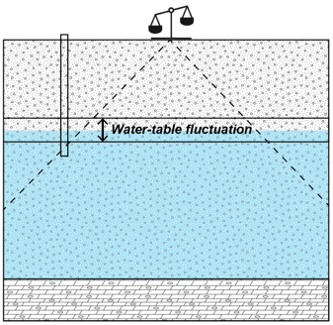
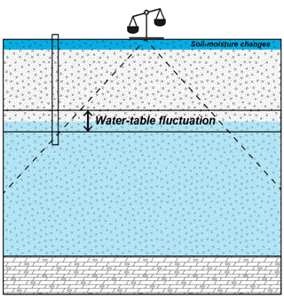
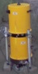

Measuring ground-water storage change with gravity
Changes in the amount of groundwater stored in underground aquifers are measured using ground-based gravity measurements
Changes in near-surface soil moisture create “noise” in the data and mask deeper aquifer changes.

Slide 4
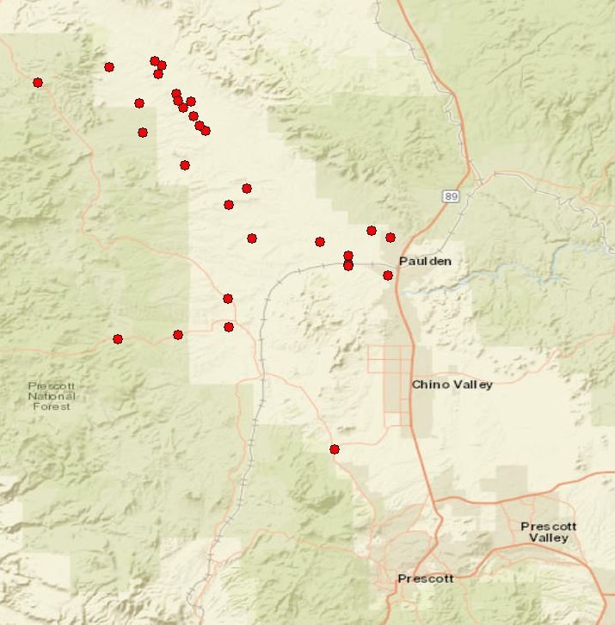
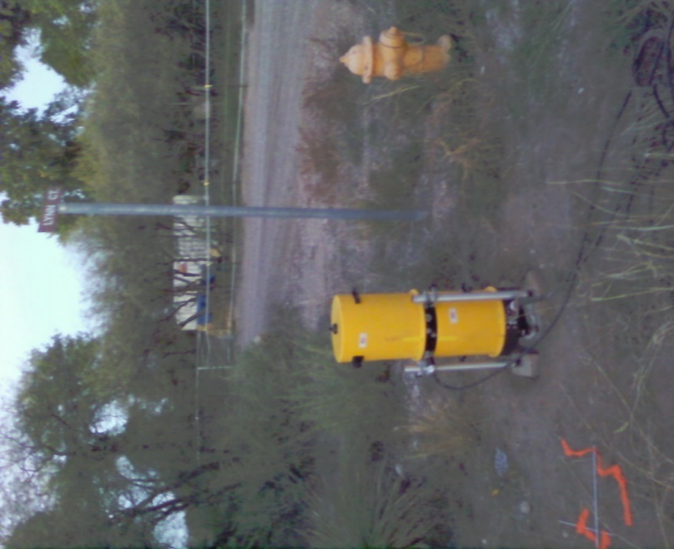
Data – gravity data
Gravity is measured using an “absolute” gravity meter that measures the acceleration of a falling mass.
Gravity measurements are made three times per year

Slide 5
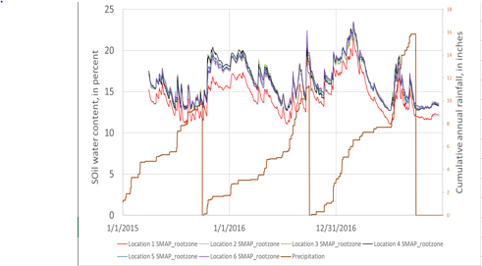
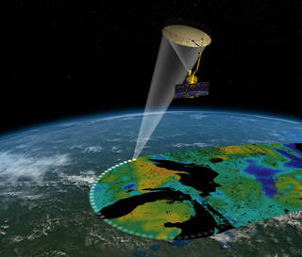
Data – Satellite Soil moisture data
SMAP….
SMAP only goes back to 2015, so we had to extend the record to 2009 using ASCAT
Soil moisture is not a direct measurement, it requires other models to account for vegetation, etc….
AirMoss…
PLOT FROM EXCEL

Slide 6
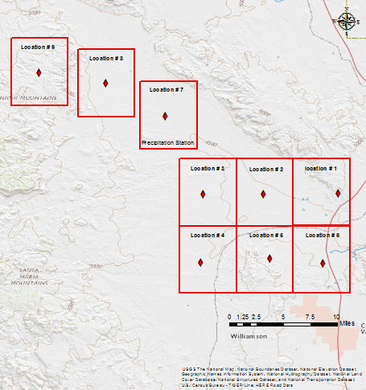
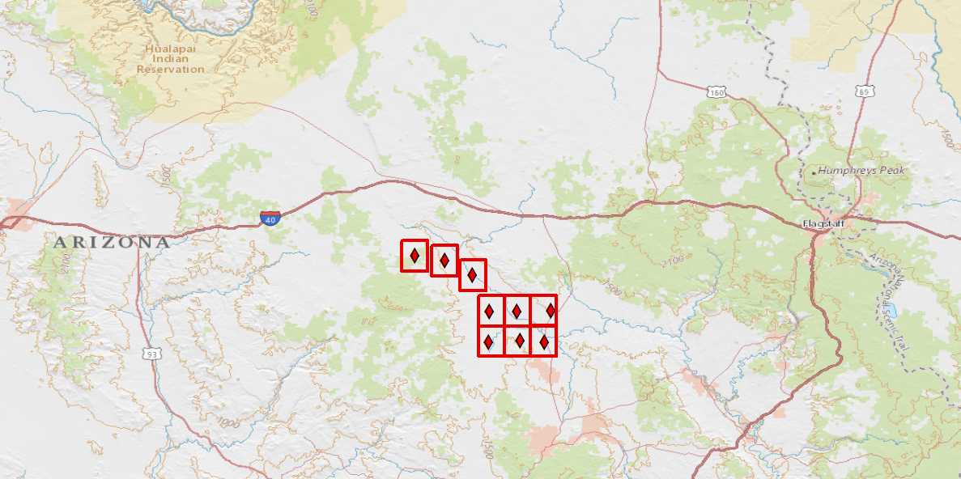
Study Area
Ash Fork
Flagstaff
Verde Valley

Slide 7
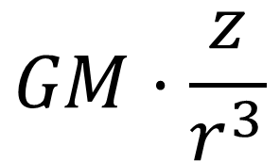
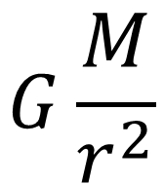
Analysis
Code in MATLAB applies Newton’s law of gravitation to grid-cell density changes that are caused by soil moisture.
Grid-cell elevations are obtained from the USGS National Elevation Dataset.
$$G\frac{M}{r^{2}}$$
$$GM⋅\frac{z}{r^{3}}$$

Slide 8
Conclusions
Plots showing raw vs. corrected gravity time series

Slide 9
Acknowledgements
Jeff Kennedy
Research Hydrologist
USGS Arizona Water Science Center, Flagstaff
Kathleen Stigmon
Sr. Program Coordinator
NAU NASA Space Grant & REU
Nadine G. Barlow, PhD
Professor and Department Chair
Director, NAU/NASA Space Grant Program
Associate Director, AZ Space Grant Consortium
Department of Physics and Astronomy

